Slide 1
Credit Card Default Classifier
David Godinez

Slide 2
The Client
The Client is a company who lends money to customers.
This Client needs to know who is more likely to default and who is more likely to pay their next bill
The repercussions of this decision could cost or save the company possibly millions of dollars

Slide 3
The Data Set
The Data set was supplied by two researchers Yeh and Lien in 2009.
The data came from a financial Institution in Taiwan in the same year.
The data had 30,000 individual customers each with 32 unique attributes and the final Y/N column regarding their payment for the month which we were training for.

Slide 4
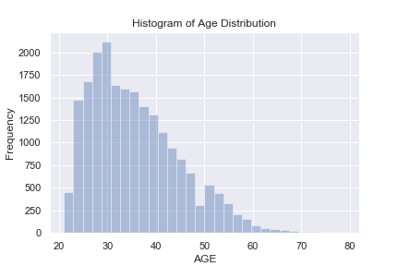
Visualizations

Slide 5
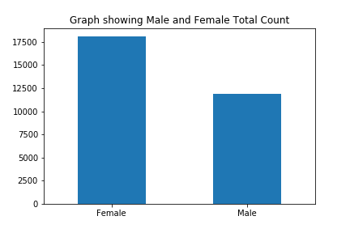
Visualizations

Slide 6
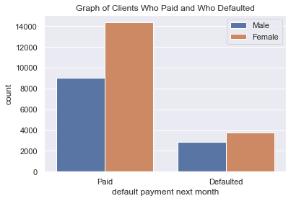
Visualizations

Slide 7
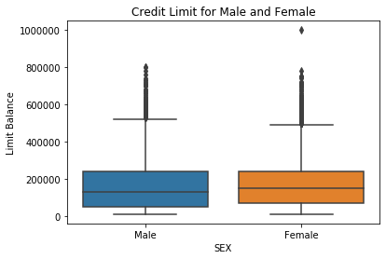
Visualizations

Slide 8
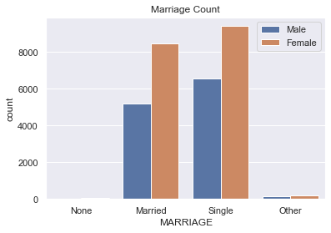
Visualizations

Slide 9
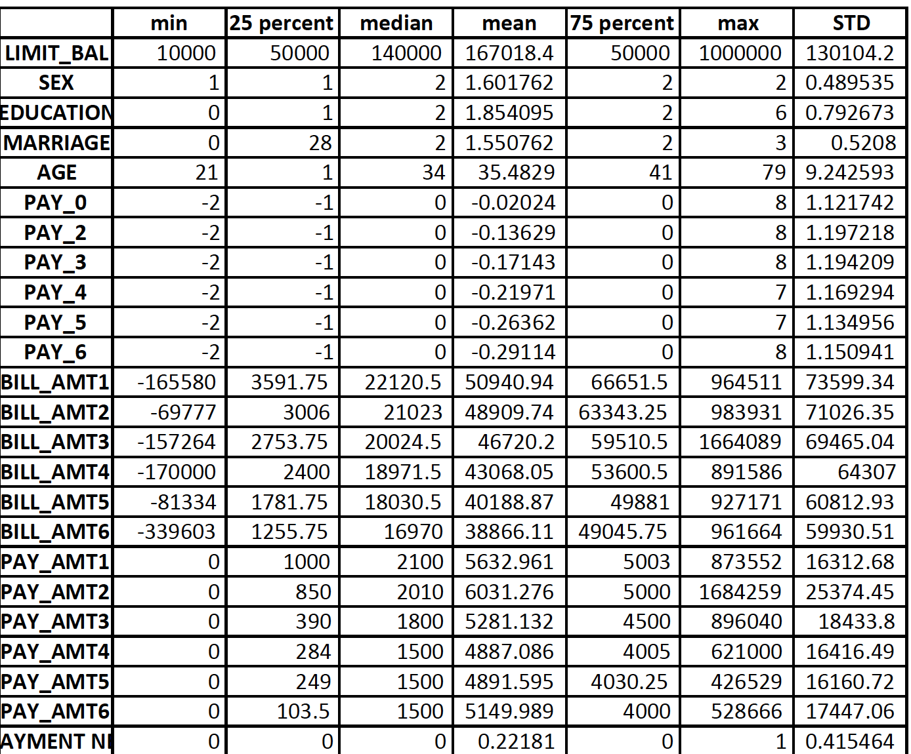
Visualizations

Slide 10
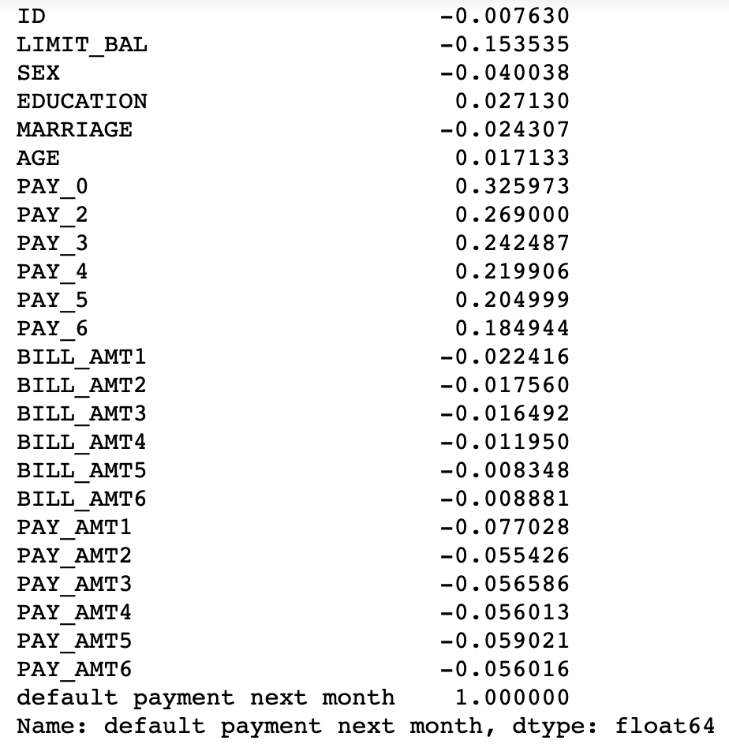
Visualizations

Slide 11
Machine Learning
Three different models were considered:
Logistic Regression
kNN
SVM

Slide 12
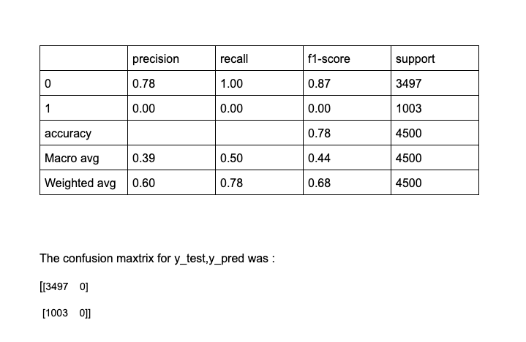
Logistic Regression

Slide 13
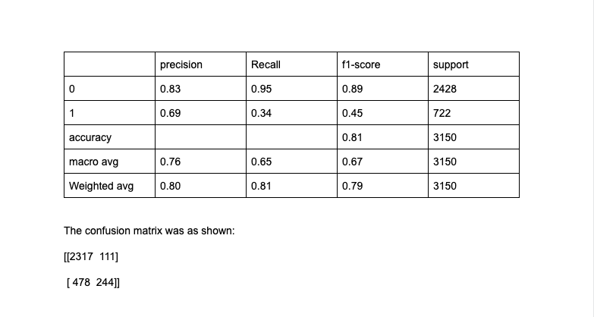
K Nearest Neighbors

Slide 14
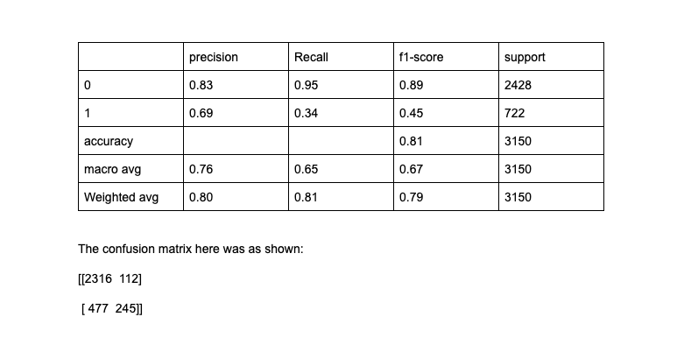
Support Vector Machines

Slide 15
Results
The Logistic Regression Model had the best performance.
This could be for several reasons, but it’s ability to deal with high dimensional data definitely could have played a large role.

